Slide 1

What’s in and what’s not: using the new global seafloor geomorphic map to examine the representativeness of global marine protected areas
Miles Macmillan-Lawler, Peter Harris, Elaine Baker, Jonas Rupp
GRID-Arendal, Geoscience Australia, Conservation International

Slide 2
Why Seafloor Geomorphology?
Seafloor geomorphology can be mapped at global scale using existing data
Is a useful surrogate for biodiversity at the global scale. i.e Seamounts have a different suite of species to Abyssal Plains
Support improved management of the marine environment (eg MSP, feature inventories)
Can be built upon using other physical and biological data

Slide 3
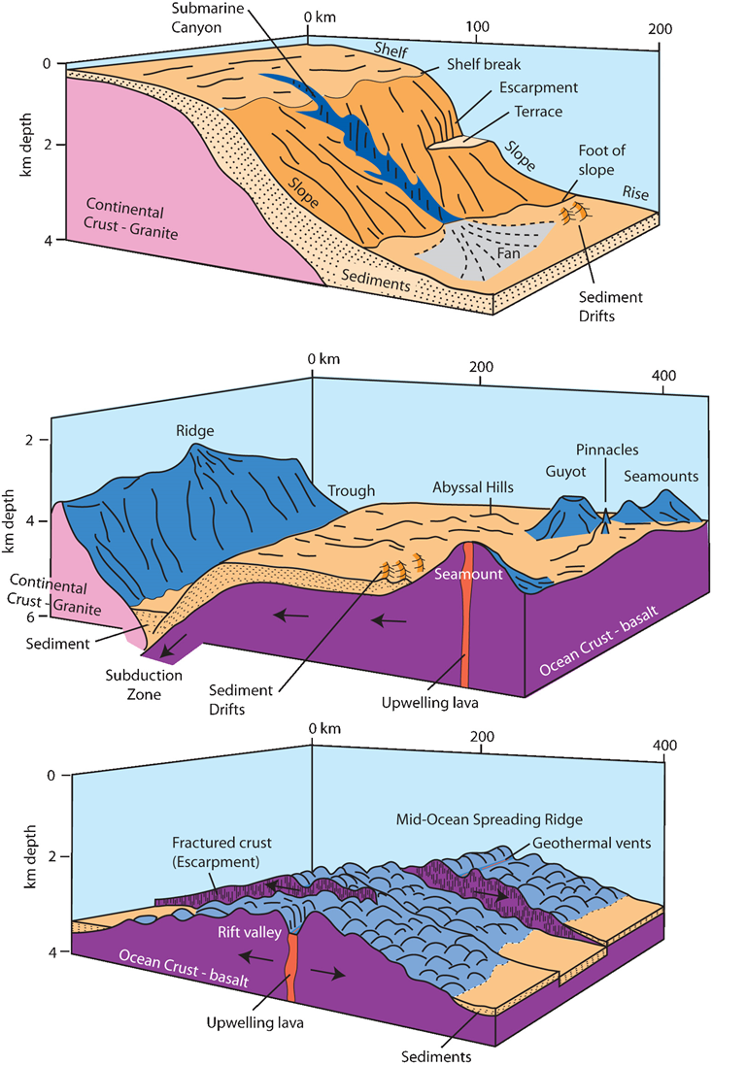
Geomorphic Feature Interpretation
SRTM30Plus v7 + other data
Features defined based on shape, slope, rugosity and TPI
Combination of automated algorithms and expert interpretation
Minimum feature size mapped ~10 square kilometres

Slide 4
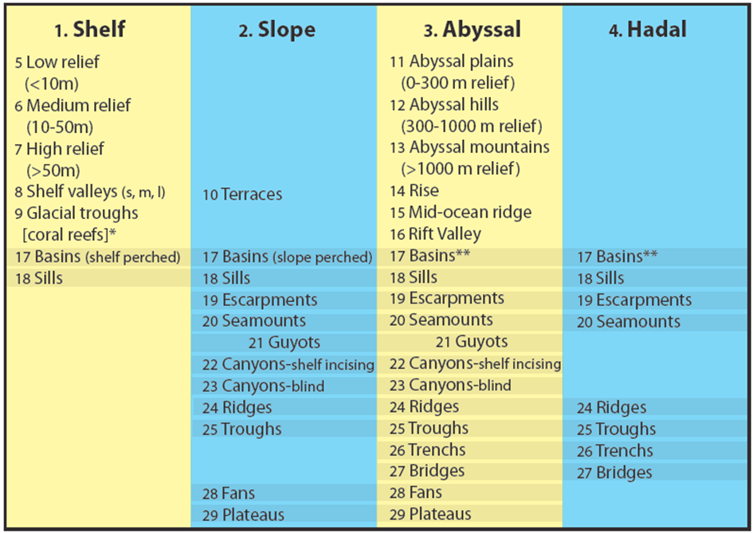
IHO Categories
Notes:
4 base features – shelf, slope, abyss and hadal
2 of these features, shelf and abyss, have been classified automatically based on rugosity
19 additional features mapped

Slide 5
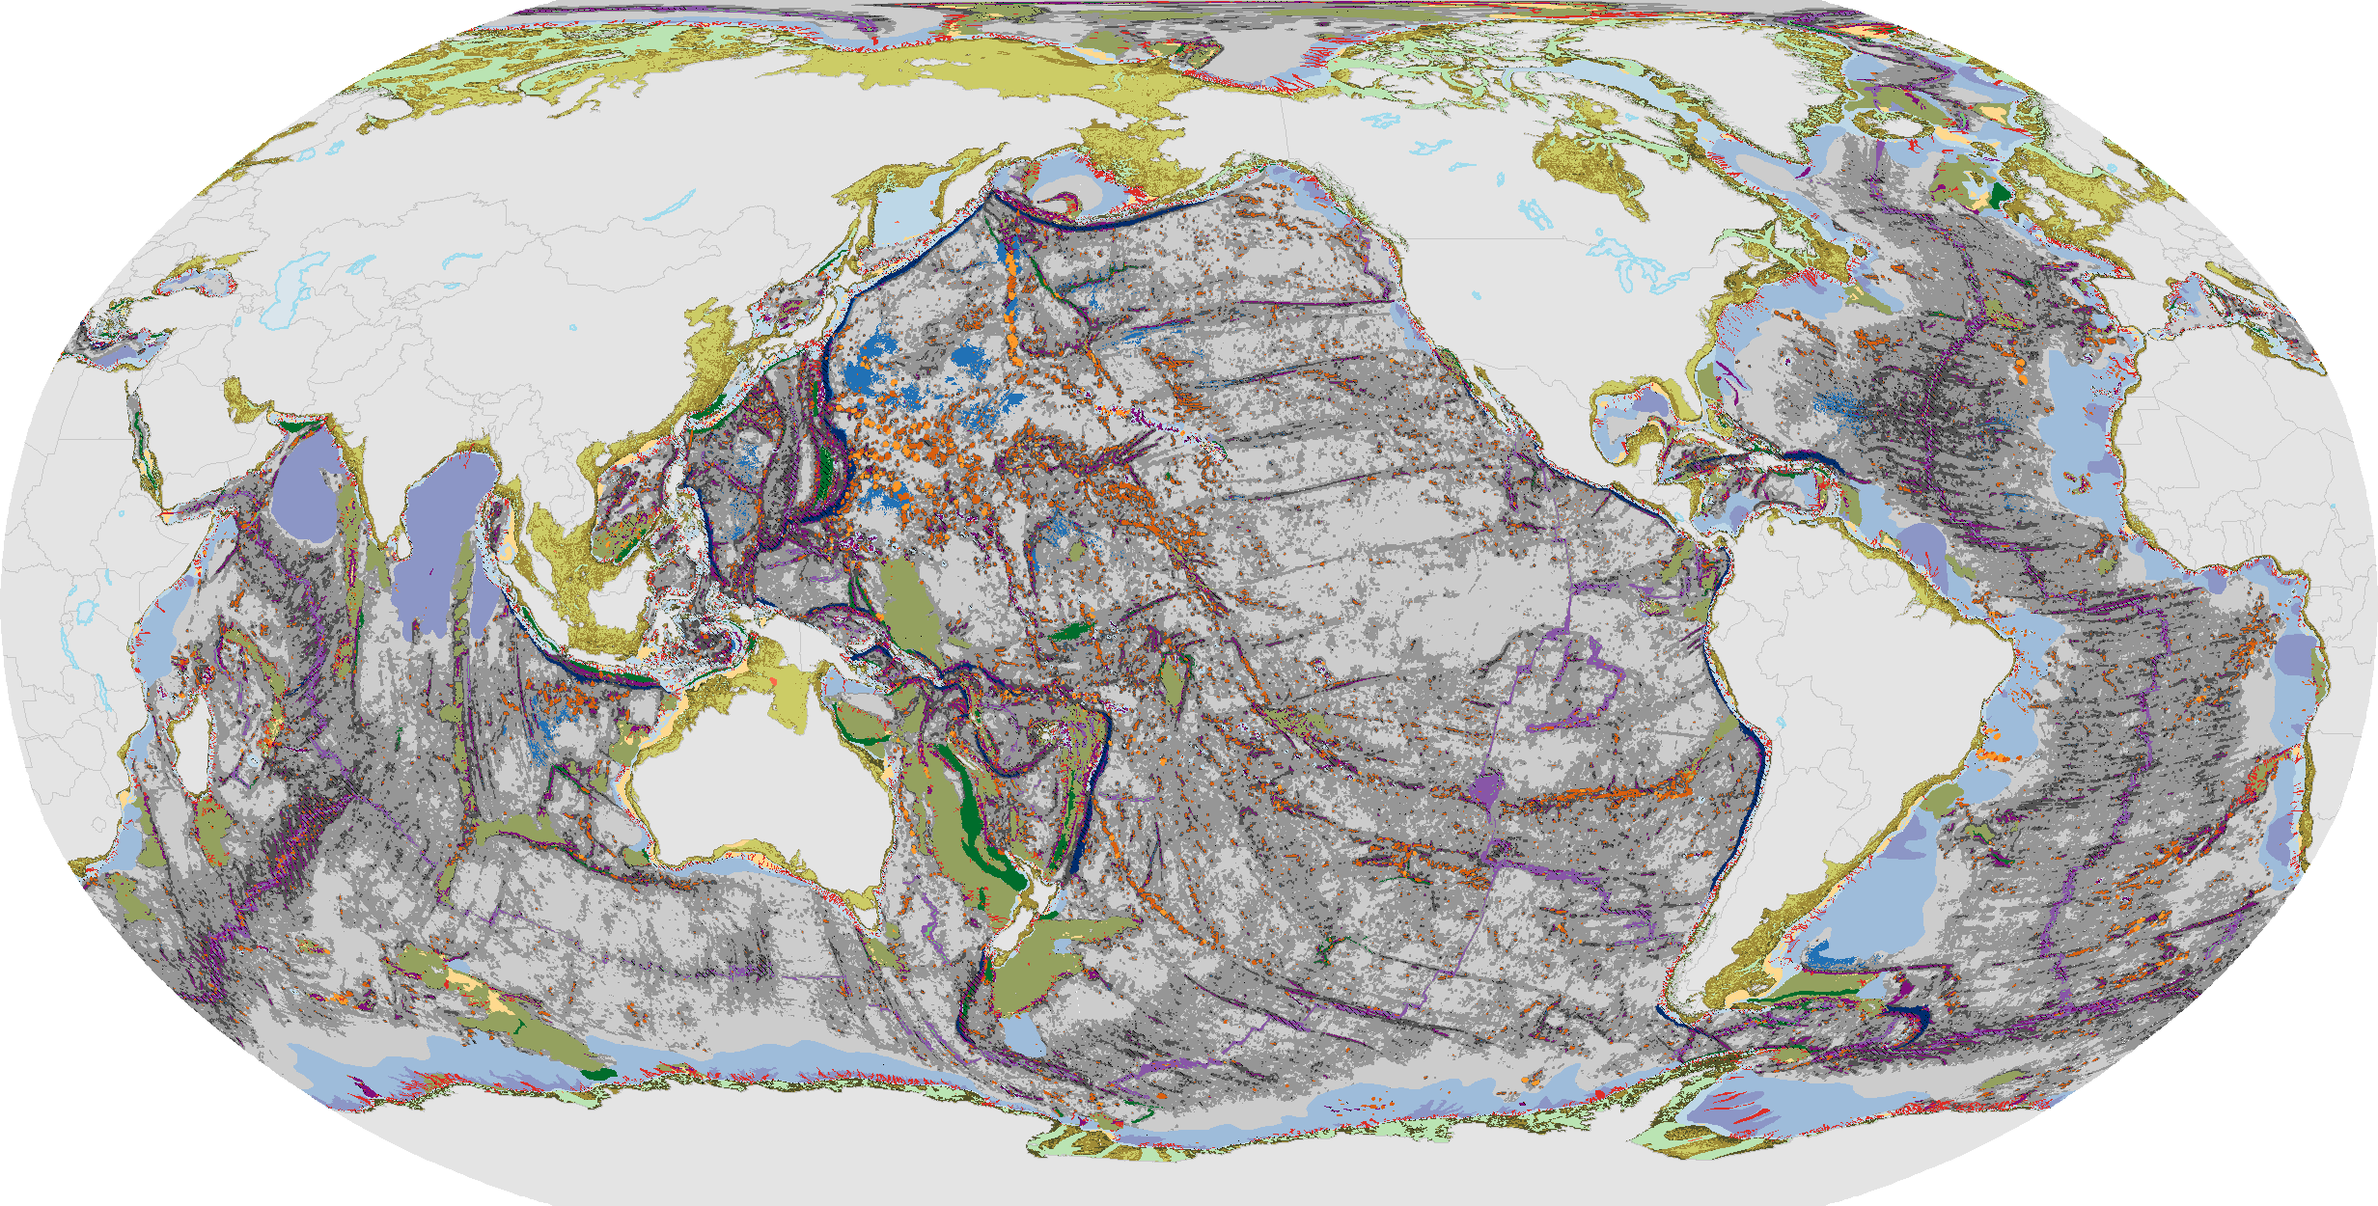
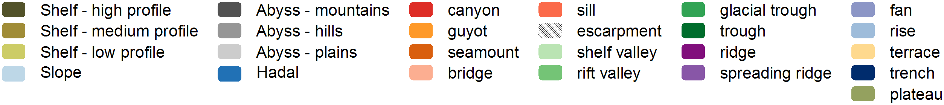
Notes:
Last 1.5 years
Mapped 29 feature types

Slide 6
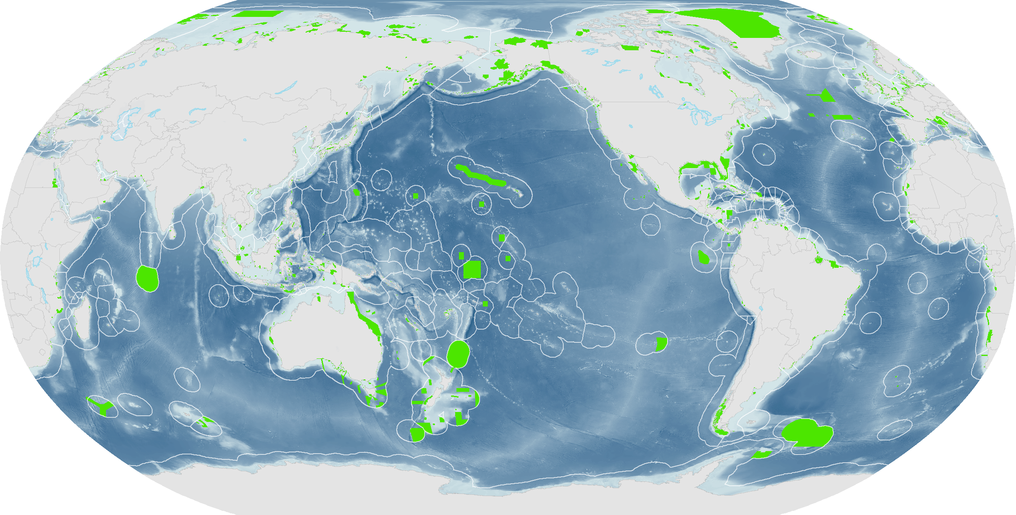
Global MPAs – WDPA
August 2013 version

Slide 7
CDB - Aichi Target 11
By 2020, at least 17 per cent of terrestrial and inland water areas and 10 per cent of coastal and marine areas, especially areas of particular importance for biodiversity and ecosystem services, are conserved through effectively and equitably managed, ecologically representative and well-connected systems of protected areas and other effective area-based conservation measures, and integrated into the wider landscape and seascape.

Slide 8
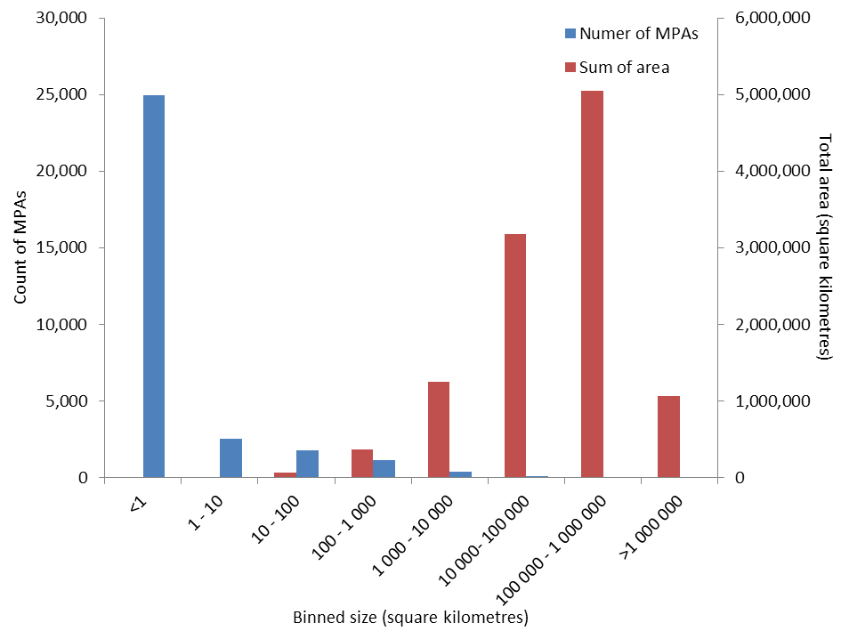
Global Status of MPAs
3% of the oceans in MPAs
97% of MPAs in EEZs
Majority of MPAs small
Majority of area from few large MPAs

Slide 9
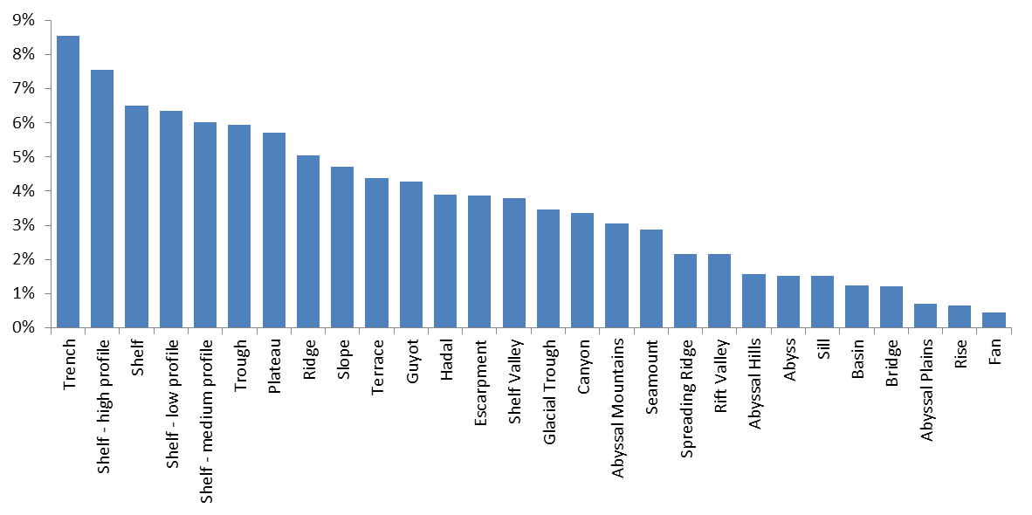
What features are represented in MPAs
Notes:
Analysed against World Database on Protected Area (August 2013)
Representation ranges from 8.5 down to 0.5%, with generally poor representation of deep sea features
Look at three deep sea features, trenches, seamounts amd troughs

Slide 10
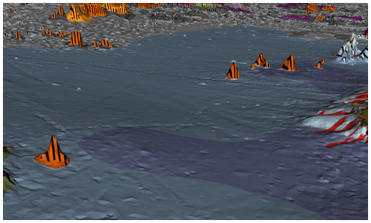
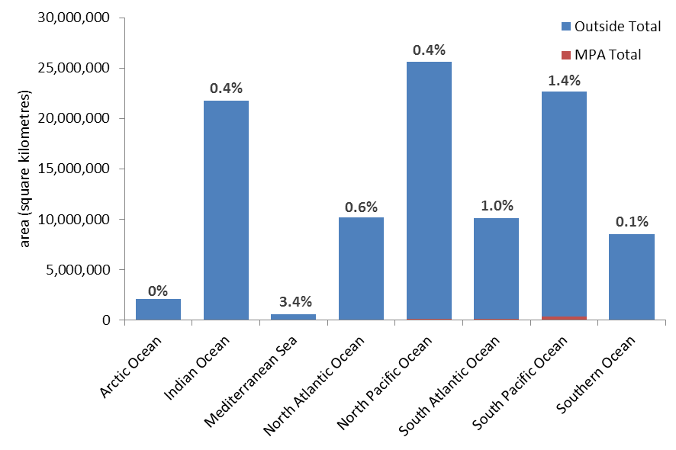
Abyssal Plains – Globally 0.7 % in MPAs
Cape Verde
Abyssal Plain
Notes:
Best in Mediterranean / Black Sea although globally less Abyssal Plain in these areas.
Indian, Nth Pacific and Sth Pacific where most = poorly represented

Slide 11
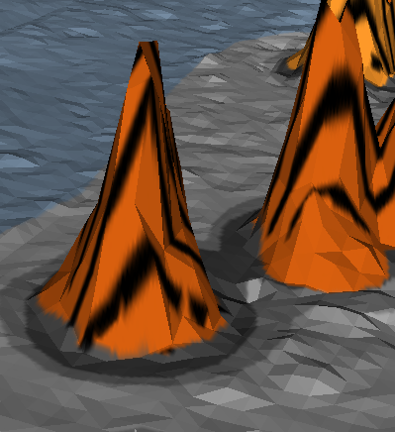
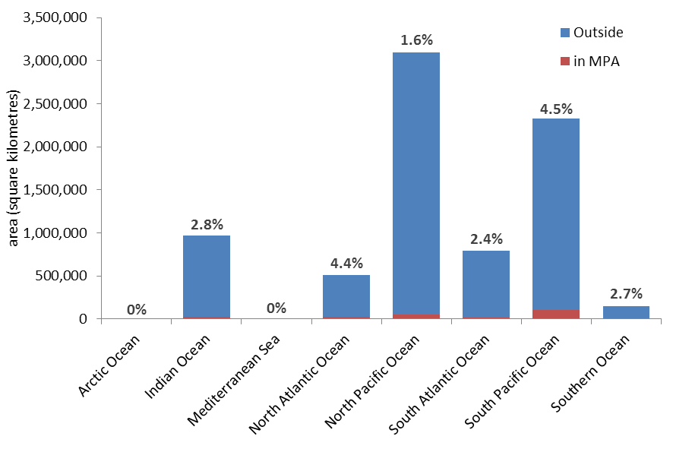
Seamounts – Globally 2.9 % in MPAs
Kelvin seamount in
northwest Atlantic
Notes:
Best representation in North Atlantic OSPAR
and South Pacific PIPA and Large NZ among others.

Slide 12
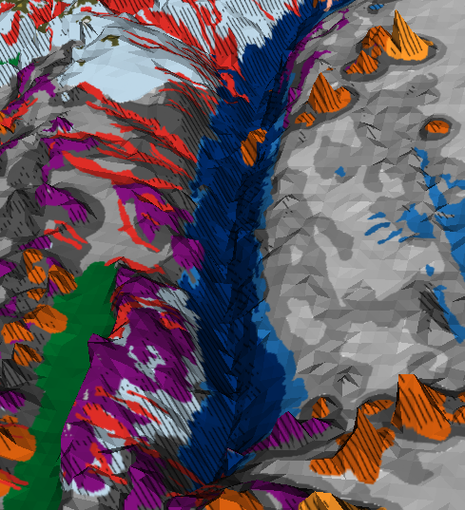
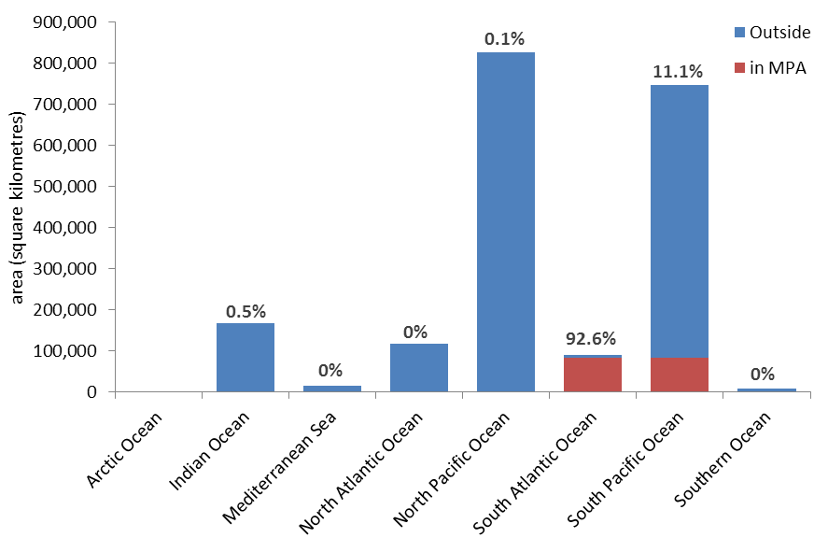
Trenches – Globally 8.5 % in MPAs
Japan Trench
Notes:
Best represented feature
However only from 2 MPAs
Kermadec MPA (NZ) in South Pacific
South Georgia and South Sandwich Islands Marine Protected Area in South Atlantic

Slide 13
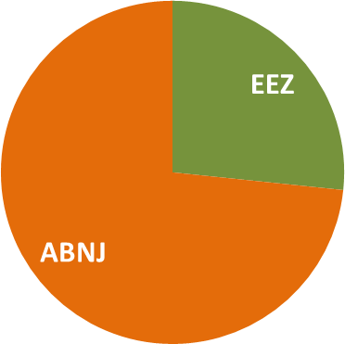
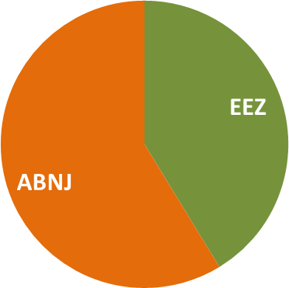
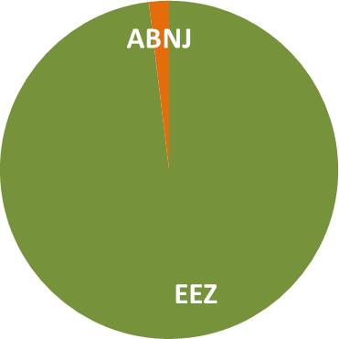
Less than 3% of MPAs are in ABNJ
Abyssal Plains
Seamounts
Trenches
Representation in MPAs
Notes:
Less than 3% of MPAs in ABNJ
Features more common in ABNJ are less well represented

Slide 14
Globally what’s in and what’s not?
Feature representation ranges from 0.5 and 8.5%
Deep water features poorly represented
Representation of features varies in the different oceans
Features in ABNJ poorly represented
Notes:
Analysis such as this can inform MPA planning

Slide 15
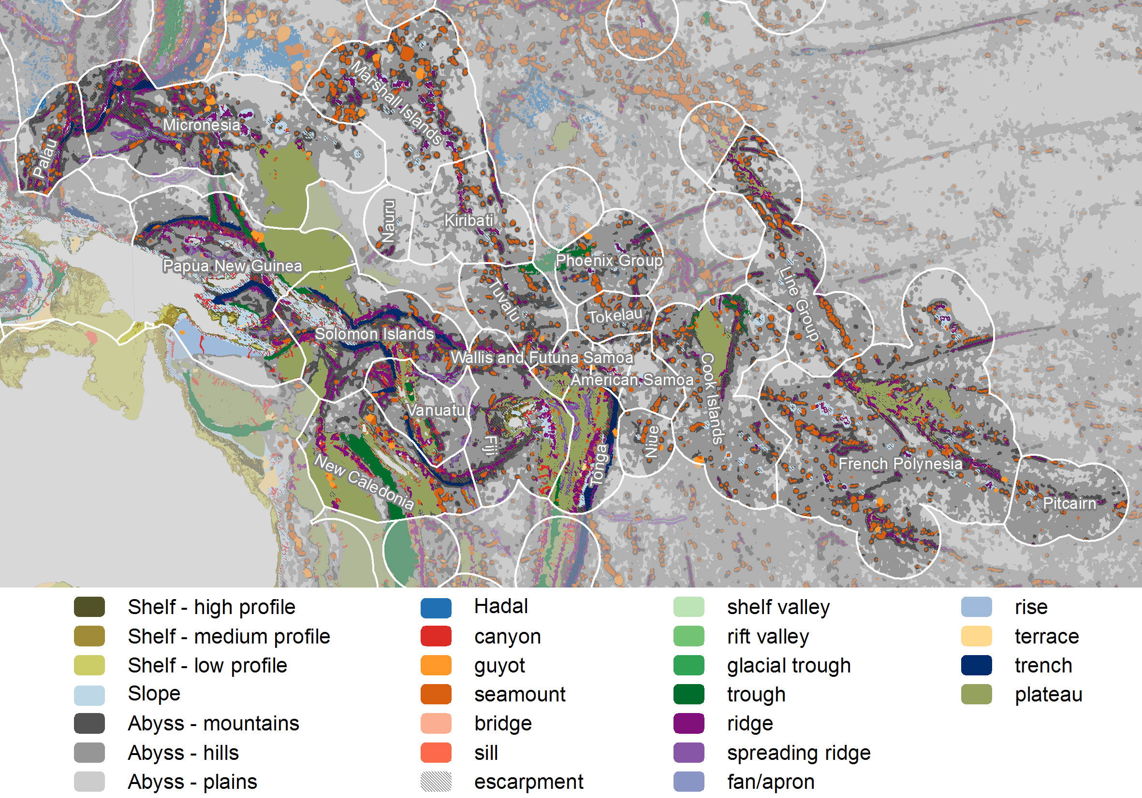
Seafloor geomorphology of the Pacific Region
Notes:
This is so cool!!

Slide 16
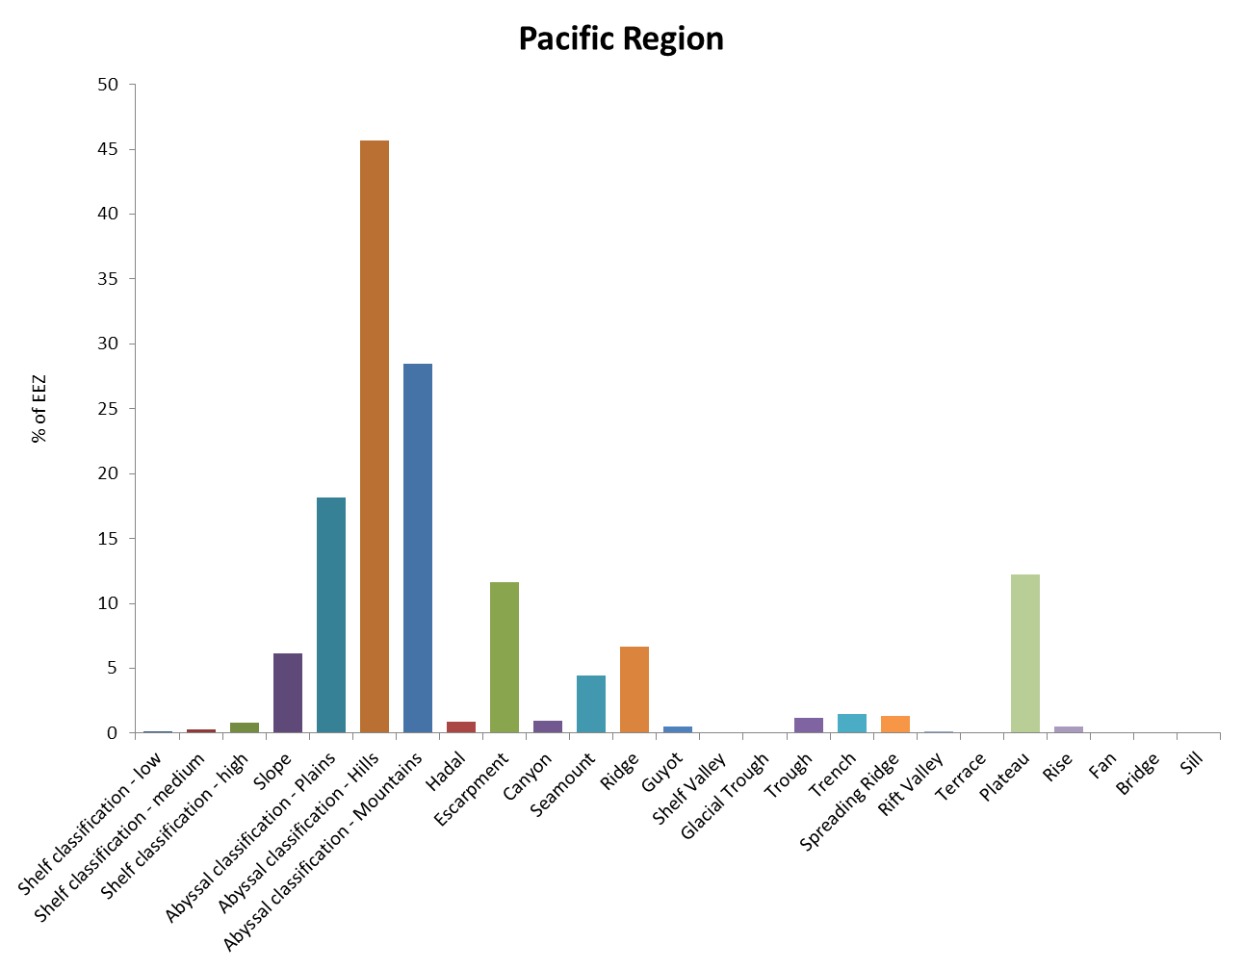
Seafloor geomorphology to characterise EEZs of the Pacific Region

Slide 17
Seafloor features of Pacific Region
 | North Pacific
Greater than global average* | Escarpment, Trench, Ridge, Plateau, Seamount, Bridge, Guyot, Abyssal mountains, Trough, Canyons
Less than global average* | Glacial Trough**, Fan**, Shelf valley, Rise, Shelf (all classes), Terrace, Sill
* compared to proportion of feature at global scale
** features not present in region

Slide 18
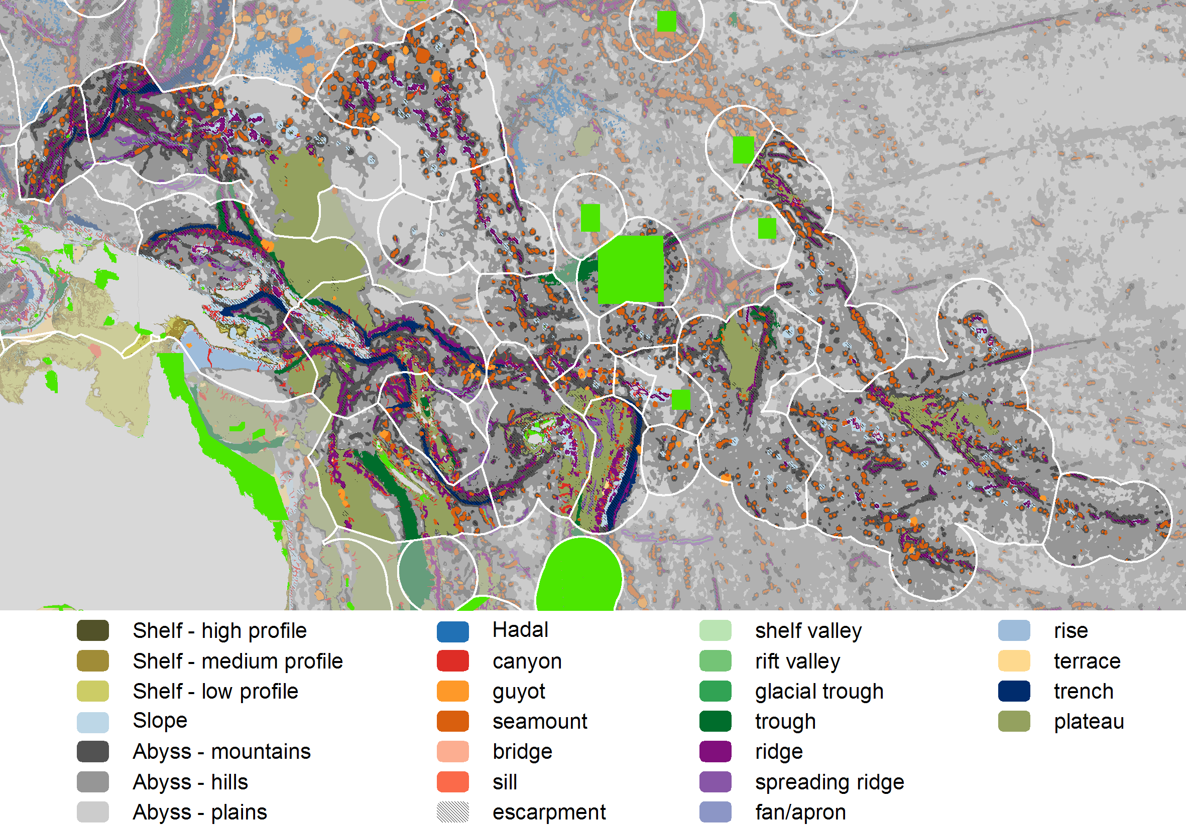
Marine Protected Areas of the Pacific Region
Notes:
Regionally 1.7% of the EEZs are represented in MPAs.
This ranges from

Slide 19
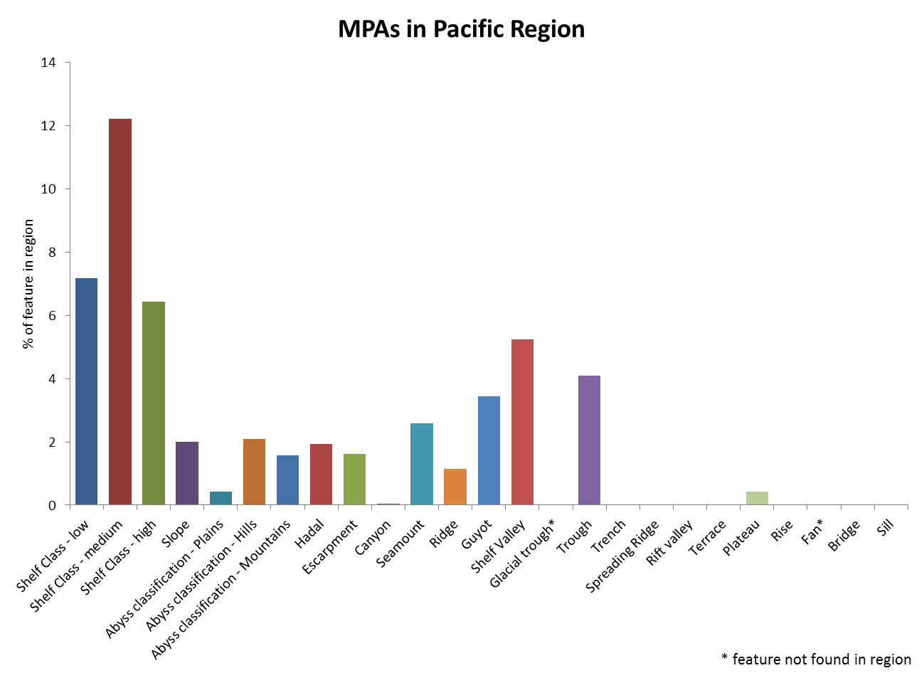
Features represented in MPAs in the Pacific Region

Slide 20
Summary of geomorphic feature representation in MPAs in the Pacific Region
The three shelf classes are the best represented features in MPAs in the region, between 6 and 12 %.
Most of the features that are characteristic of the region (e.g. escarpments, seamounts, abyssal mountains, ridge and guyot) are represented between 1.5 and 3.5 % of their area in MPAs
Several ecologically significant features not represented in MPAs in the region (eg canyons, spreading ridges, rift valleys)

Slide 21
Summary
Seafloor geomorphology provides an insight into how global MPAs are achieving the Aichi Target 11
Especially useful in assessing whether global MPAs are capturing areas of particular importance for biodiversity and if they are ecologically representative
Seafloor geomorphology can be used to identify gaps in MPA coverage

Slide 22
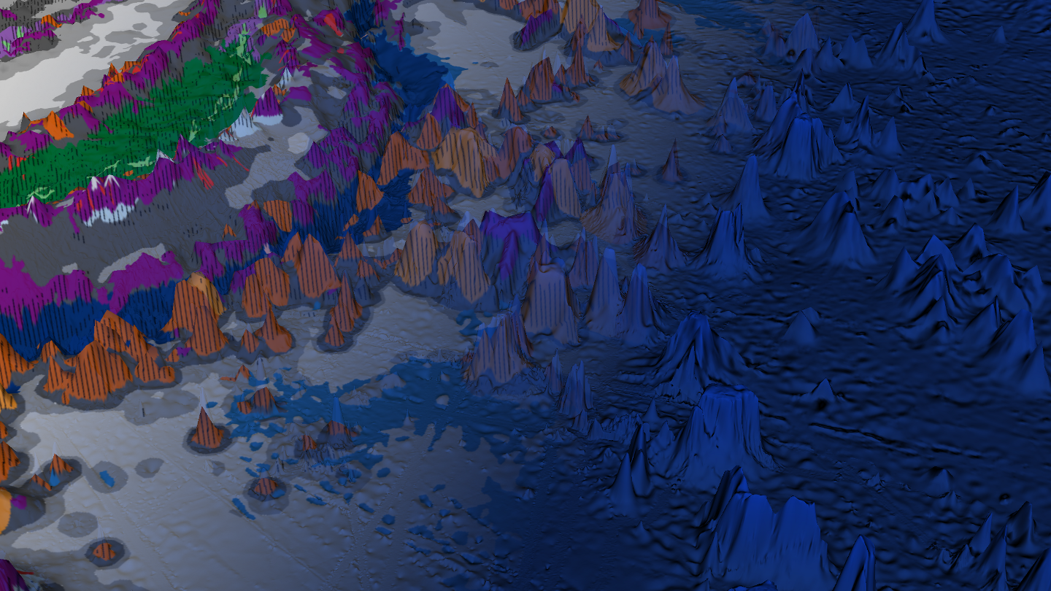
Questions?
miles.macmillan-lawler@grida.no
grida.no
bluehabitats.org (comming soon)

